Slide 1
Angular Applications with ASP.NET Core Backends
Rick Strahl
West Wind Technologies
west-wind.com
Weblog.west-wind.com
Session materials:
https://goo.gl/kgGpDp

Slide 2







About the Presenter
Rick Strahl
Big Kahuna West Wind Technologies
Author and Speaker
Popular Blog: weblog.west-wind.com
ASP.NET Insider and MVP
Tools and Components
@RickStrahl
rstrahl@west-wind.com
weblog.west-wind.com

Slide 3
Modern Web Development
Lots has changed in the last 5 years
From Server based HTML Rendering
To all UI rendered on Client
Client centric development
Rich, much more interactive clients
Client side logic for UI management
Stateful clients
Servers used primarily for Data
Today's Applications use Web APIs
Business Logic
No longer generate UI (MVC/WebForms of old)

Slide 4

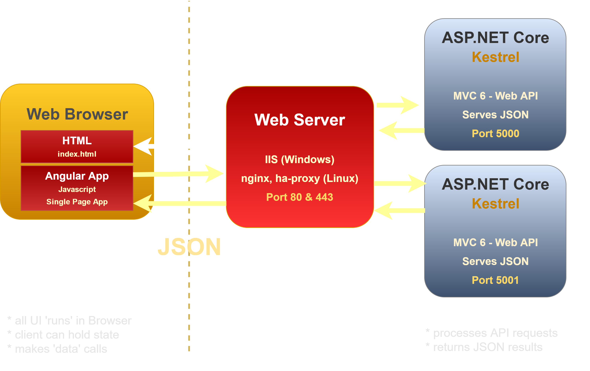




Angular and ASP.NET Core

Slide 5

What is Angular
JavaScript Application Platform
Full featured framework for building JS Apps
Modular JavaScript Code
Covers most common Client Application scenarios
Features
Module System (ES6/Typescript)
Powerful two-way DataBinding
HTML Template Binding
Client Side MVC
Reactive Event System (rxJs)
Easy HTTP support
Form Validation
Routing
Component Model

Slide 6
Why Angular?
Declarative Programming
Write your code to a model not the DOM
Remove DOM spaghetti code
Drastically reduced code size
Data is live – change the value the UI changes!
Support features: Http, Validation, Routing etc.
Modular JavaScript
Hardest problem in JavaScript is managing code
Module system brings class like system
Atomic code through components as building blocks
Full Featured
Unified paradigm for most application ops
Can be used as only library
Angular is a platform – everything in one place

Slide 7
Angular (4)
Requires Build Pipeline
Requires JS build system and transpilation (Typescript->ES5 or ES6->ES5)
Angular CLI makes getting started much easier
Overwhelming amount of dependencies and tech
Just get started – don't get caught up in the details
Typescript or ES6
Not just a script file to add to a page
Very complex internal architecture, but easy to use
Learning curve is steep but short
Big Improvements
Simpler Binding Syntax
Much better performance
Simplified Object Model – Everything is a Component
Using Typescript and Modules is easier to manage

Slide 8
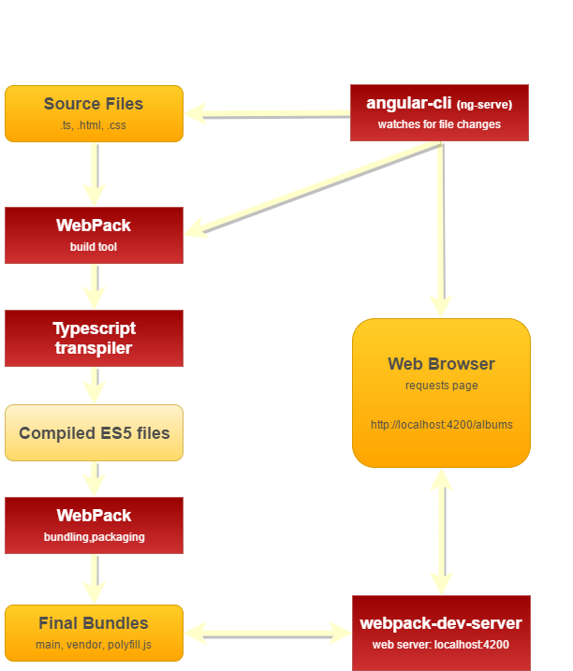
Angular/Typescript Build Process

Slide 9

Typescript
A better JavaScript
Superset of JavaScript – all JavaScript is valid!
ES5 and ES6 compatible syntax (part of mission statement)
Provides many additional features
Requires Transpilation (as does ES6)
Features
Real Classes (based on ES6)
Module System (based on ES6)
Optional strong typing (name:Address = new Address())
Meta Data Support (annotations used in Angular)
Tooling support: Typescript Service
Excellent Intellisense support in many editors

Slide 10
Getting Started with Angular
Use the Angular CLI
Provides most dev/build features in one place
ng serve – run live reload web server
ng build – build production ready builds
ng generate – create components/services
Don't get bogged down
Initially – JUST DO IT!
Follow the walkthrough - guidelines
Ignore the pile of tech involved
Pick up the tech as you go and need it
Rock on!
After initial tech overload Angular is very productive

Slide 11
Start Simple
There’s a lot to learn
No need to understand it all, all at once
Start with what you need to get started
Pick up more advanced features later
Start With:
Creating Components & Services
DataBinding & Event handling
Understanding ES6/Typescript
Lots of good examples and templates exist
Learn as you go
Use the documentation – it’s excellent
Lots of good examples out there – code by numbers
StackOverflow
Easiest way is to learn by doing
Learn as you go and circle back to more advanced topics

Slide 12
Key Features
Classes as Components
Classes are the 'model'
All dependencies are declared up front
Constructor Dependency Injection
Module Loading
Breaks up JavaScript code by class
Allows for script file dependencies to be found
DataBinding
Two-way databinding (also one way bindings)
Clas properties bind to the View
<div>{{property}}</div> - literal binding
[(ngModel)]="property" – control binding
Event Handling
(click)="method" – event binding
Event Emitter – publish events

Slide 13
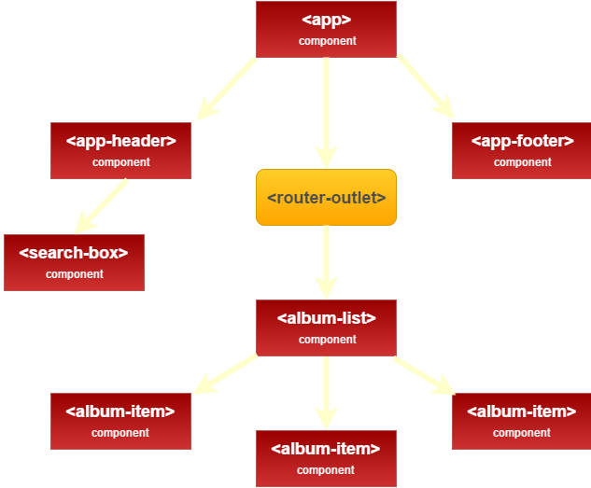
Angular Classes as Components

Slide 14
What's a Component?
Typescript Class
Properties are the 'model'
Methods are the event handler
MetaData
Describes component characteristics and dependencies
Templates
HTML Template holds the 'View' for the component
Templates can be strings (.Template)
Templates can be files (.TemplateUrl)
Compiled into JavaScript
Compiled into the output bundle (main.browser.js)

Slide 15
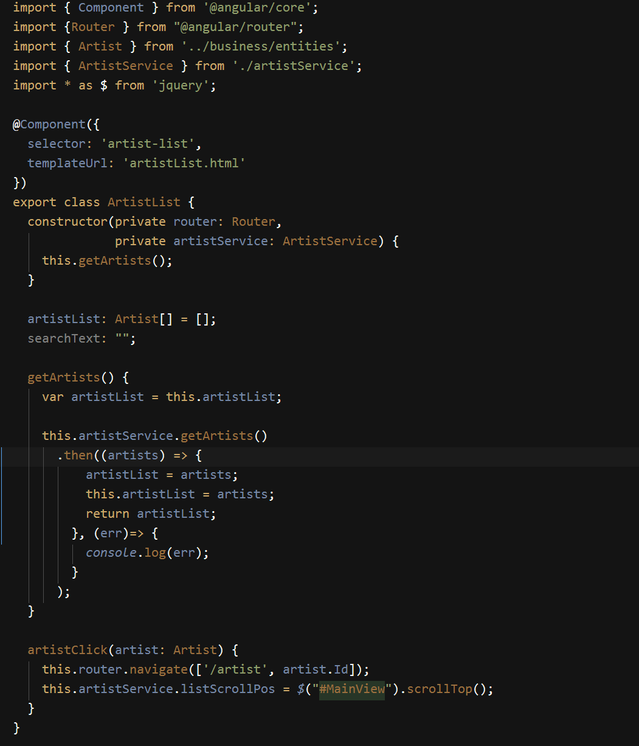
Typescript Classes as Components
Import dependencies
Component meta data
Class definition
dependencies are injected in ctor
Properties for model binding
Methods for event binding

Slide 16
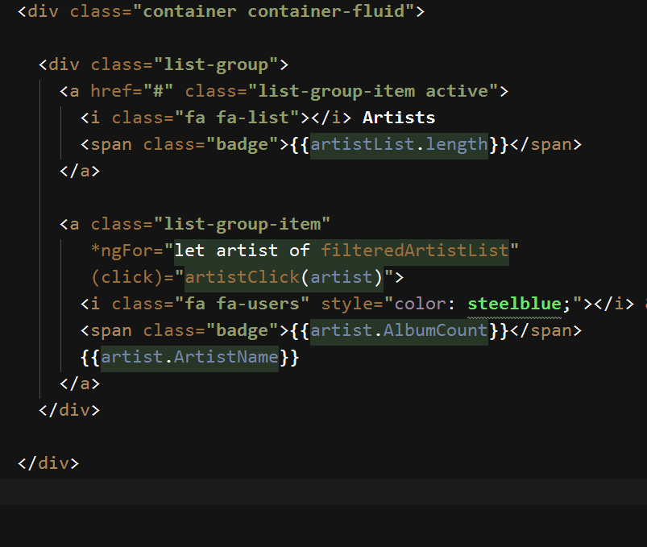
Html View
{{ Literal Bindings}}
*ngFor – looping component
(event) binding

Slide 17
Angular Component Templates
Databinding
HTML Markup with enhancements
Template tags: {{ expression }}
One way binding: [attribute]="expression"
Two way binding: [(ngModel)]="expression"
Event binding: (click)="method()"
Databinding works against any attribute and event!
Directives
*ngIf – conditional rendering of element
*ngFor – loop construct
[ngClass] = "{selected: activeTab == 'options'}"

Slide 18
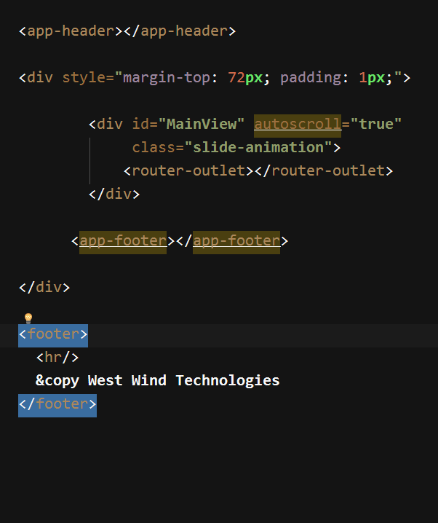
Top Level Composition
Component
View Outlets (router) renders a router view
Component

Slide 19
Angular MV*
Html Page (index.html)
Template (View)
html/css
Html template
Displays rendered content
Component (Controller)
Javascript
properties hold Model data
drives View logic
uses services to load Model
Service (Model) Javascript fetches data
can persist data
business/logic rules

Slide 20
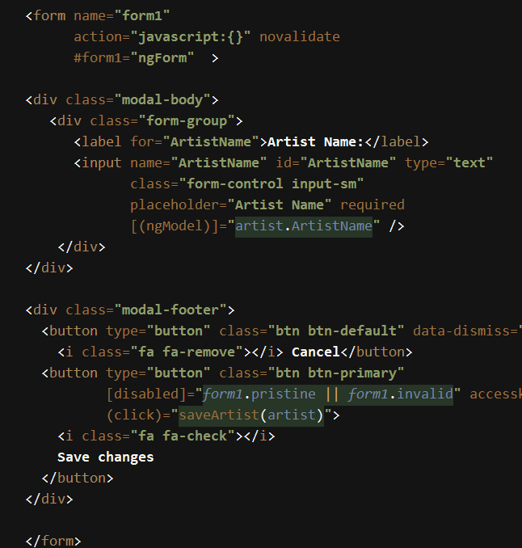
Forms and Form Validation
Binding
ngModel binds inputs
[(ngModel)]="property"
Banana in box
Form Validation
Powerful form validation
Use DOM validations
CSS Classes for state:
ng-valid
ng-invalid
ng-touched
ng-pristine
#form1="ngForm"
form1.invalid expression

Slide 21
Angular Coponent Classes
Components are the Traffic Cop
‘CodeBehind’ for Views
Responsibility: Update the model for the View
Sit between Model and the View
Sets up Model data for binding
Coordinates between Services and Model to retrieve data
Feeds its model to the View
Keep it simple!
Break out your components
Many components per feature page
Offload ‘business logic’ and data request to services
Try to ALWAYS use the Model to update display and incur event behavior
Revert to DOM and jQuery only if you have to

Slide 22

ASP.NET Core on the Server
Complete re-write of ASP.NET
Platform Independent
Windows, Linux
Works great on Docker
Modular
Everything loads with NuGet package
Only what you need – sort of
High Performance
Kestrel Web Server (TechEmpower)
Lower memory usage than classic ASP.NET
More scalable for Cloud operation

Slide 23

ASP.NET & .NET Core
ASP.NET
Web API
MVC
Web Pages
Middleware
ASP.NET Kestrel Web Server
Full .NET CLR
.NET Core CLR
Host
Self-hosted
OS

Slide 24
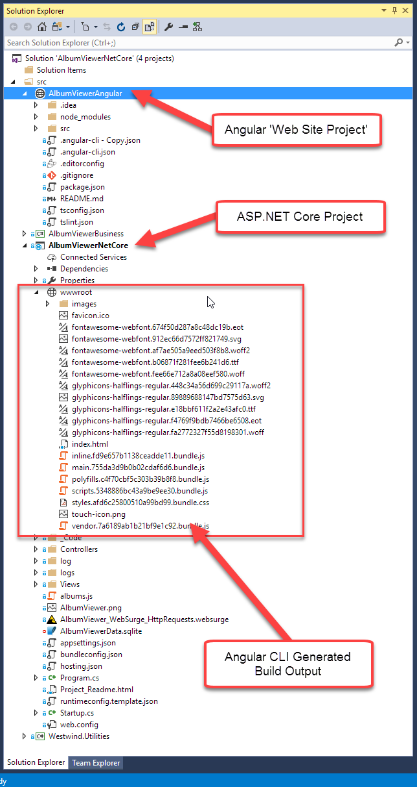
Angular & ASP.NET Core
Use Separate Projects
Core Project for API
Web Site Project for UI
Mark node_modules hidden
Typical Dev Usage
Angular runs ng-serve dev server
ASP.NET runs Kestrel
Or runs IIS Express
Command Line Tooling
Run ng-serve for Angular
Run dotnet run for ASP.NET Core
VS Code, Web Storm integrate Terminal

Slide 25
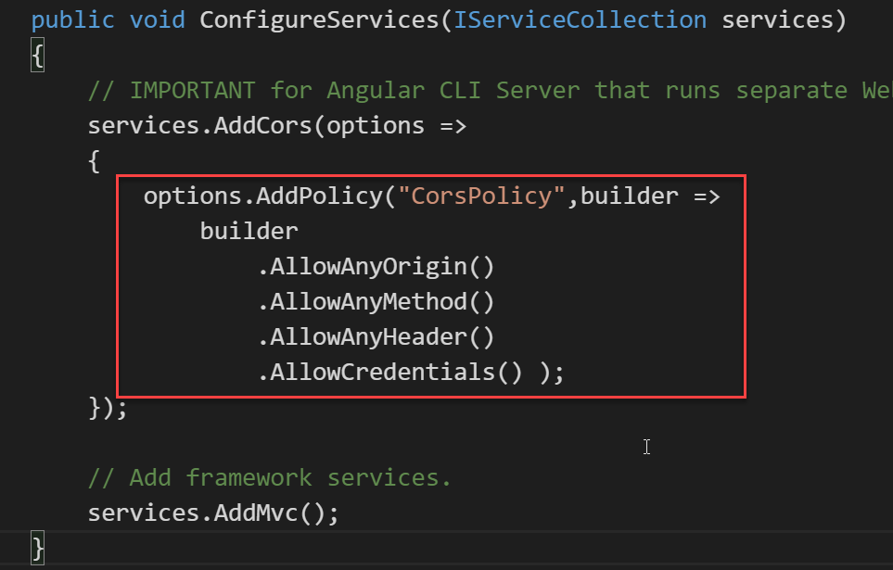
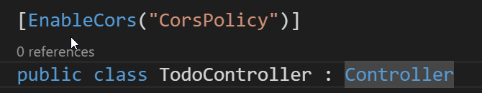
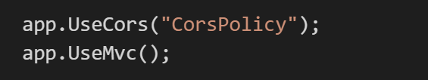
Angular and ASP.NET Core
Configure CORS in ASP.NET Core
Build Output to wwwroot
Send Angular CLI build output to wwwroot
Allows ASP.NET Core App to run full App in Production
or

Slide 26
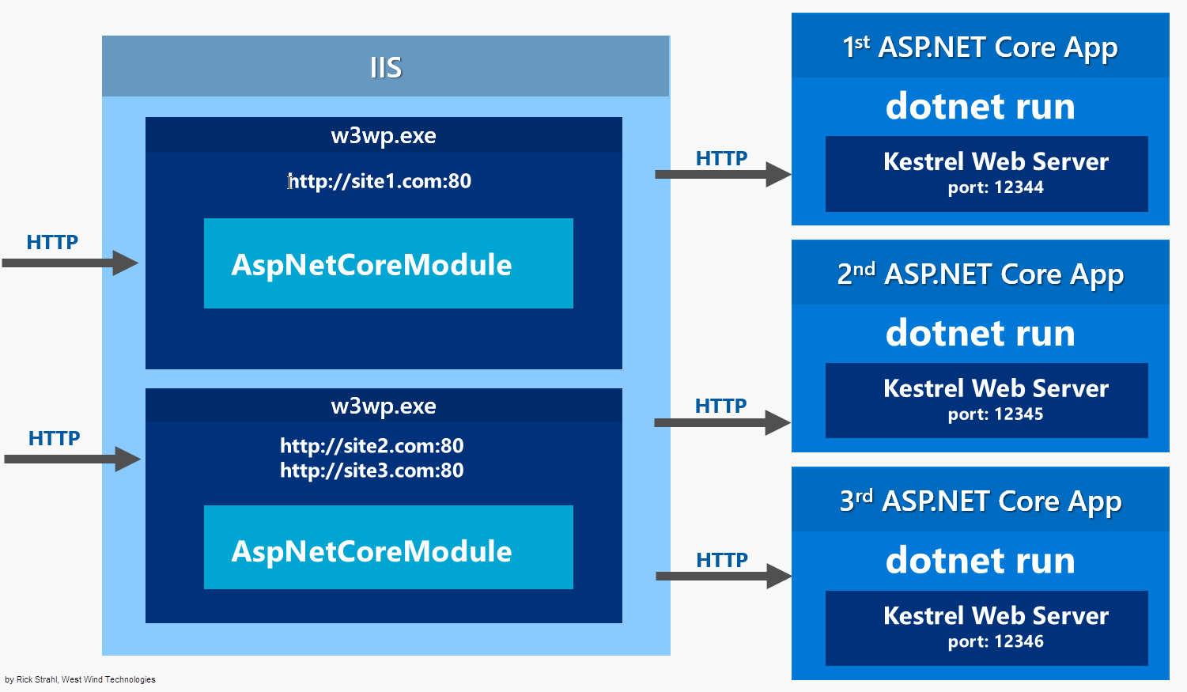
ASP.NET Core on IIS

Slide 27
Let IIS Serve Static Content
AspNetCoreModule
Forwards all requests from IIS to Kestrel
Includes all files – static, and application
Static Content
Kestrel is slow with static content
Let Web Server front end handle statics
IIS – Use IISRewrite
Rewrite static file Url
Rewrite HTML 5 Client Routing
Everything else passed to Kestrel

Slide 28
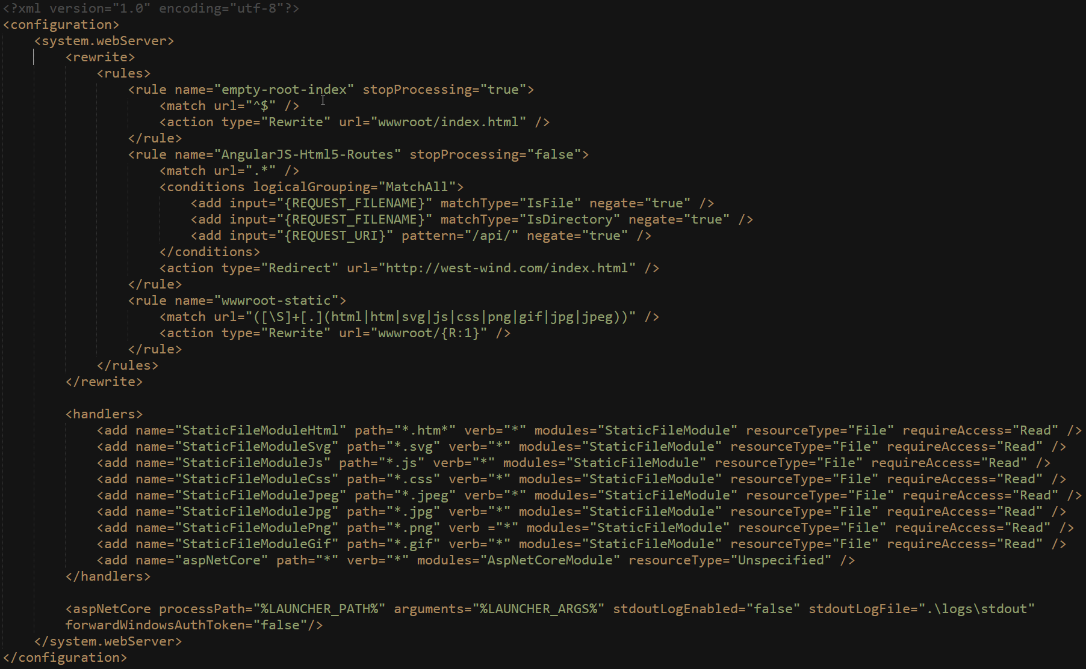
IIS Rewrite Rules for Static Files/HTML 5 Routes

Slide 29
Publishing ASP.NET Core on IIS
ASP.NET Core Apps are published
dotnet publish creates a publish folder
Publish folder is self contained
Runtimes
Support libs
Your compiled binaries
VS Publish and MsDeploy
Existing tools work to deploy to a live Web site
Make sure `ASP.NET Server

Slide 30
Angular 2.0 Summary
Powerful framework
End to end client side framework
Modular JavaScript using TypeScript
Two way databinding
DataBinding changes Everything!
Separation of code and DOM Manipulation
Model updates bind DOM values
Changes are real-time
Learning Curve
Initial learning curve is omnious
Actually building apps is easy through
Once you learn the 5 or so common concepts you can apply them for 90% of what you need to know
Google is your friend!

